Slide 1



NLP & LLMs
AI Bootcamp
Text Classification using CNNs
Dr Usman Zia
Asst Professor
SINES, NUST
usman.zia@sines.nust.edu.pk
usman.zia@sines.nust.edu.pk
linkedin.com/in/usmanxia/

Slide 3

Deep Learning
Introduction to Deep Learning
Deep learning (DL) is a machine learning subfield that uses multiple layers for learning data representations
DL is exceptionally effective at learning patterns

Slide 5




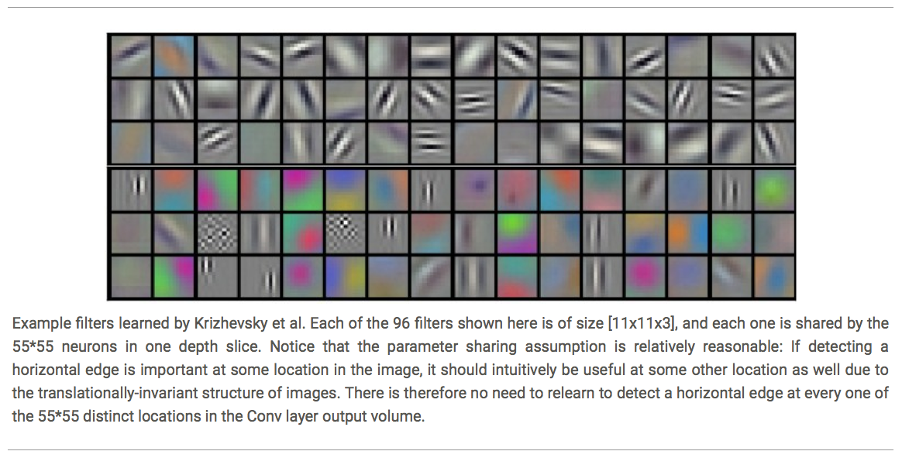




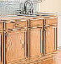






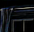

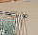
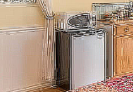
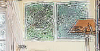
Deep Learning
Introduction to Deep Learning
DL applies a multi-layer process for learning rich hierarchical features (i.e., data representations)
Input image pixels → Edges → Textures → Parts → Objects
Low-Level Features
Mid-Level Features
High-Level Features
Trainable Classifier
Output

Slide 7
Deep Learning
Introduction to Deep Learning
DL provides a flexible, learnable framework for representing visual, text, linguistic information
Can learn in supervised and unsupervised manner
DL represents an effective end-to-end learning system
Requires large amounts of training data
Since about 2010, DL has outperformed other ML techniques
First in vision and speech, then NLP, and other applications

Slide 8
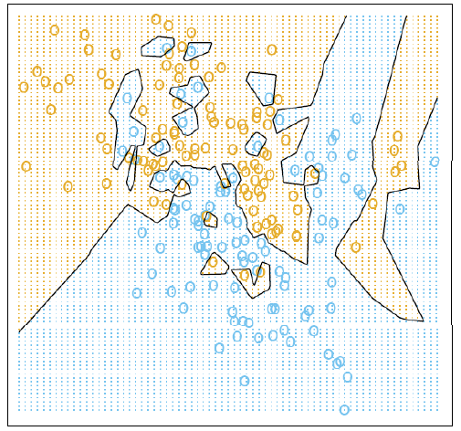
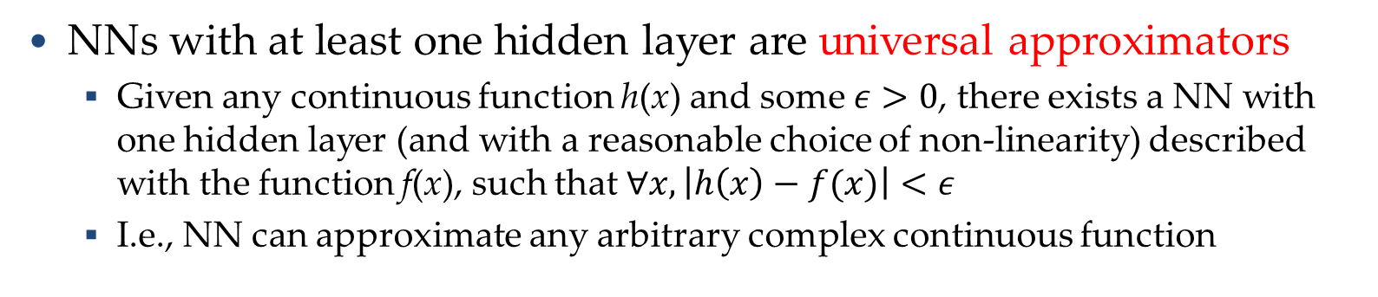
Representational Power
Introduction to Deep Learning
NNs with at least one hidden layer are universal approximators
Given any continuous function h(x) and some $ε>0$, there exists a NN with one hidden layer (and with a reasonable choice of non-linearity) described with the function f(x), such that $∀x, \left|h\left(x\right)−f(x)\right|<ε$
I.e., NN can approximate any arbitrary complex continuous function
NNs use nonlinear mapping of the inputs x to the outputs f(x) to compute complex decision boundaries
But then, why use deeper NNs?
The fact that deep NNs work better is an empirical observation
Mathematically, deep NNs have the same representational power as a one-layer NN

Slide 9
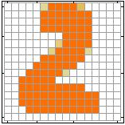
Introduction to Neural Networks
Introduction to Neural Networks
Handwritten digit recognition (MNIST dataset)
The intensity of each pixel is considered an input element
Output is the class of the digit
Input
Output
y₁
is 1
0.1
y₂
is 2
0.7
The image is “2”
……
……
……
y₁₀
0.2
is 0
16 x 16 = 256
Ink → 1
No ink → 0
Each dimension represents the confidence of a digit

Slide 10
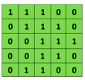

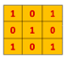
Convolutional Neural Networks (CNNs)
Convolutional Neural Networks
Convolutional neural networks (CNNs) were primarily designed for image data
CNNs use a convolutional operator for extracting data features
Allows parameter sharing
Efficient to train
Have less parameters than NNs with fully-connected layers
CNNs are robust to spatial translations of objects in images
A convolutional filter slides (i.e., convolves) across the image
Convolutional
3x3 filter
Input matrix

Slide 11
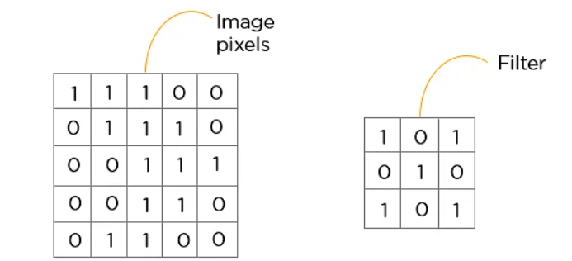
Convolutional Neural Networks (CNNs)
Convolutional Neural Networks
Convolutional Layers
A convolution layer has several filters that perform the convolution operation.
Every image is considered as a matrix of pixel values.

Slide 12

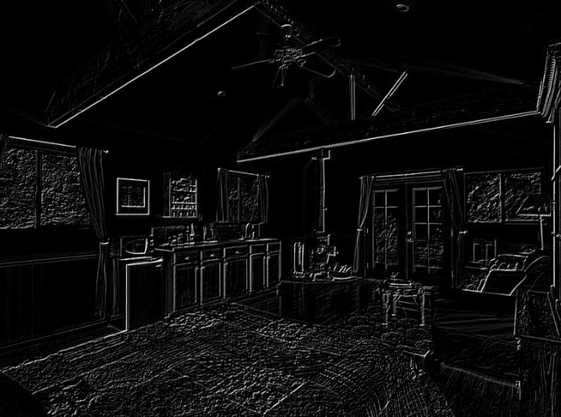
Convolutional Neural Networks (CNNs)
Convolutional Neural Networks
Convolutional Layers
When the convolutional filters are scanned over the image, they capture useful features
E.g., edge detection by convolutions
Convolution later is typically followed by an activation layer (ReLU being most used activation layer)
0 1 0
1 -4 1
0 1 0
Filter
Input Image
Convoluted Image

Slide 13
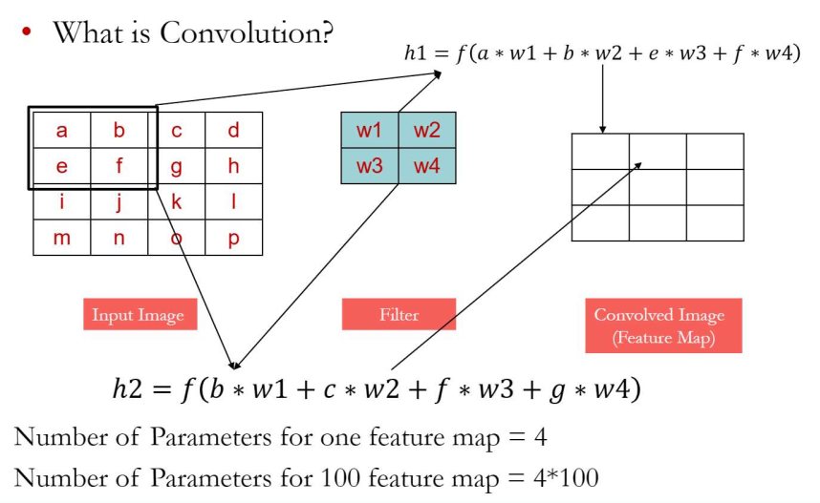
Convolutional Neural Networks (CNNs)
Convolutional Neural Networks

Slide 14
Convolutional Neural Networks (CNNs)
Convolutional Neural Networks
In CNNs, hidden units in a layer are only connected to a small region of the layer before it (called local receptive field)
The depth of each feature map corresponds to the number of convolutional filters used at each layer
w1 | w2
w3 | w4
w5 | w6
w7 | w8
Filter 1
Filter 2
Input Image
Layer 1 Feature Map
Layer 2 Feature Map

Slide 15
Convolutional Neural Networks (CNNs)
Convolutional Neural Networks
Pooling Layer is a down-sampling operation that reduces the dimensionality of the feature map. The rectified feature map now goes through a pooling layer to generate a pooled feature map.
Type of Pooling Layers
Max pooling: reports the maximum output within a rectangular neighborhood
Average pooling: reports the average output of a rectangular neighborhood
Pooling layers reduce the spatial size of the feature maps
Reduce the number of parameters, prevent overfitting
MaxPool with a 2×2 filter with stride of 2
1 | 3 | 5 | 3
4 | 2 | 3 | 1
3 | 1 | 1 | 3
0 | 1 | 0 | 4
4 | 5
3 | 4
Output Matrix
Input Matrix

Slide 16

Convolutional Neural Networks (CNNs)
Convolutional Neural Networks
Feature extraction architecture
After 2 convolutional layers, a max-pooling layer reduces the size of the feature maps (typically by 2)
A fully convolutional and a softmax layers are added last to perform classification
Living Room
Bedroom
64
64
128
128
256
256
256
512
512
512
512
512
512
Kitchen
Bathroom
Conv layer
Max Pool
Outdoor
Fully Connected Layer

Slide 17
Convolutional layer in NLP
Convolutional Neural Networks
Problem 1: Variable-sized input
standard MLP always expect the same input size
Problem 2: Relevance of words
“to” and “a” are not very informative, but content words like “kidnapping” are important for most tasks independent of their position in the input
Problem 3: MLP may have too many parameters (“too complex models”) in certain situations

Slide 18
Convolutional layer in NLP
Convolutional Neural Networks
Sentiment classification
The movie was really good. We saw this really good movie.
The movie, which we saw yesterday with all the colleagues in this tiny movie theater next to the bridge, was (despite my expectations) really good.
For this task, position information does not really matter.

Slide 19
Convolutional layer in NLP
Convolutional Neural Networks
Text Flow is
Usually only one dimension as opposed to two dimensions (or even three) in images
Convolutional networks in NLP are also called time-delay neural networks (TDNN)
Text Processing by CNNs
Input sentence x_{i:i+n} are stacked word embeddings of dimensionality d
Convolutional filter w ∈ R^{h×d}
where h is the filter size (how many neighbouring words are convoluted)
Convolution operation w ∗ x_{i:i+n}
Non-linear operation
c_{i} = ReLU(w ∗ x_{i:i+n} + b)

Slide 20
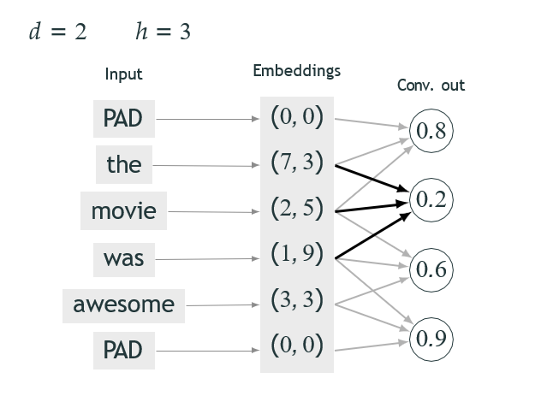
Example
Convolutional Neural Networks

Slide 21
Example
Convolutional Neural Networks
Not every input is connected to every output in the following layer
sparse connectivity (vs fully-connected/dense layers)
For each window, use the same weights and bias values
parameter sharing

Slide 22
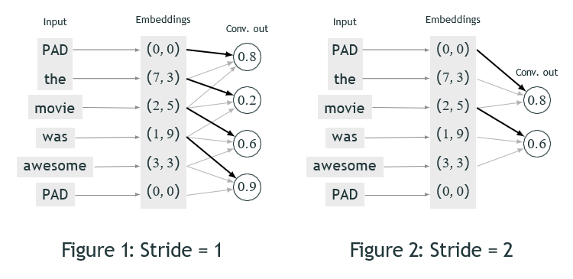
Stride
Convolutional Neural Networks
Stride: the step size for moving over the sentence
Stride 1 common in NLP; other values in comp. vision

Slide 23
Dense layer vs. Convolutional Layer
Convolutional Neural Networks
In principle, a convolutional layer could handle variable-sized inputs
But in practice, it handles fixed-sized input, just like in an MLP
We usually pad with zeros so that all sequences in our data have the same length
Sometimes we also truncate
But how to classify text after convolution??

Slide 24
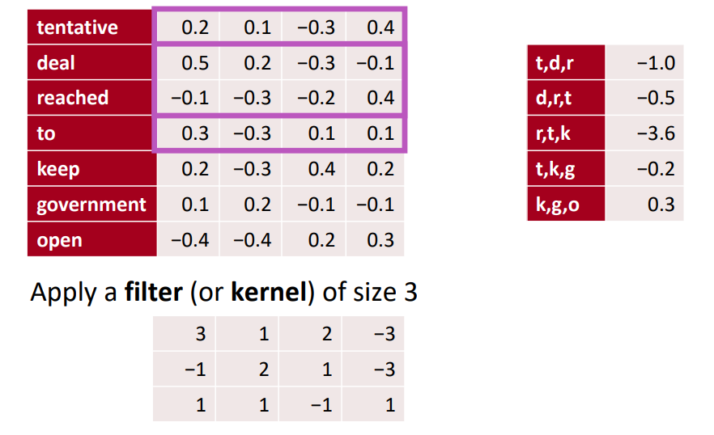
A 1D convolution for text

Slide 25
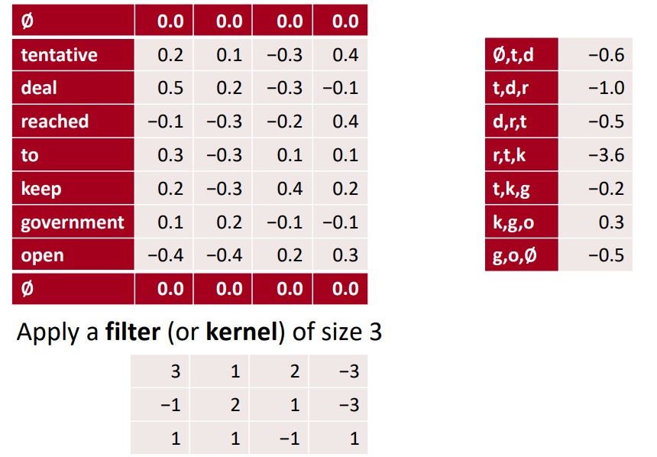
1D convolution for text with padding

Slide 26
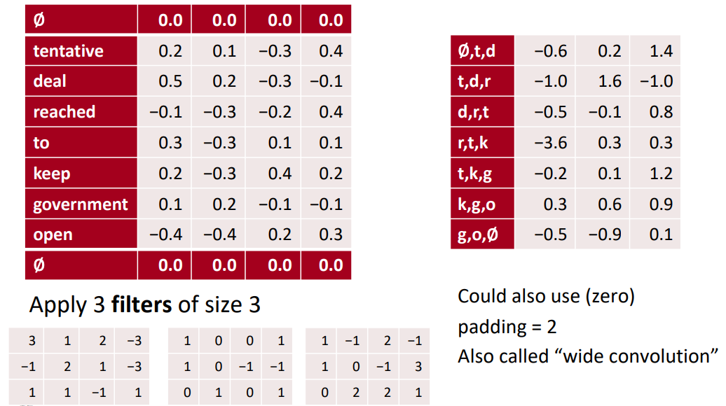
3 channel 1D convolution with padding = 1

Slide 27
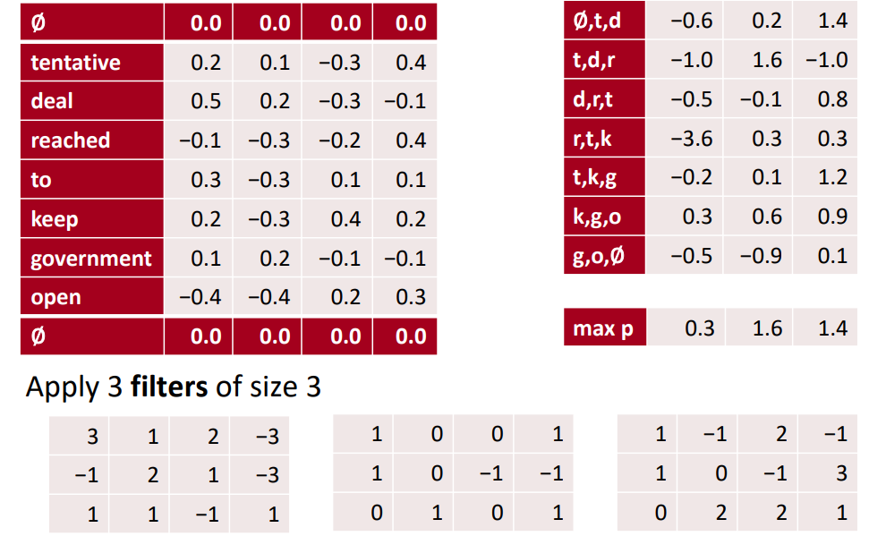
conv1d, padded with max pooling over time

Slide 28
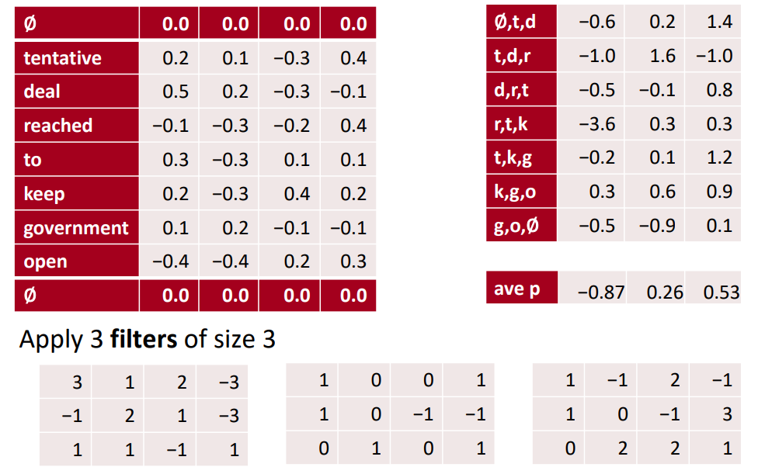
conv1d, padded with ave pooling over time

Slide 29
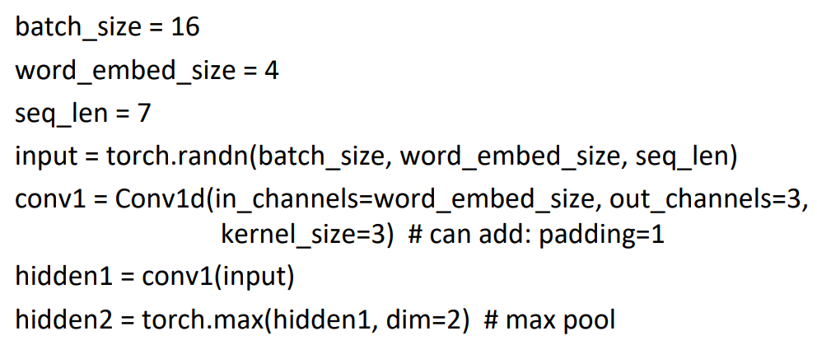
In PyTorch

Slide 30
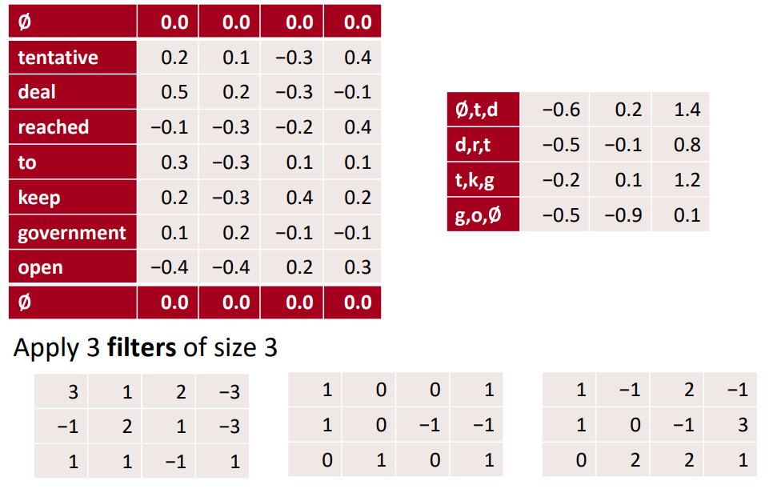
Other less useful notions: stride = 2

Slide 31
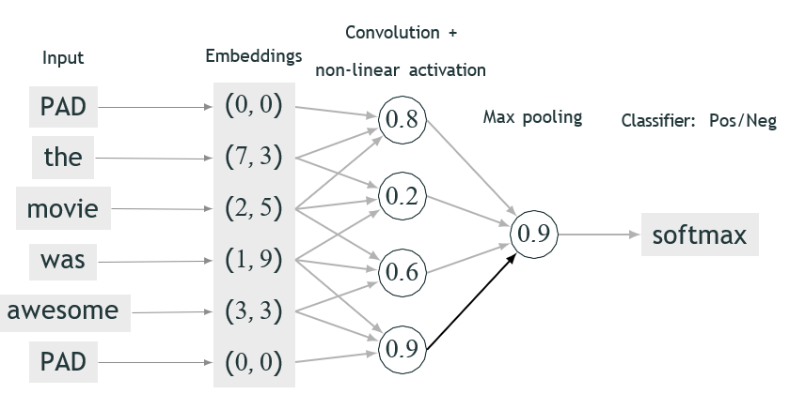
Classification with convolution and pooling
Convolutional Neural Networks
Usually we have many filters (hundreds or thousands), not just one
They may be of same or of different sizes

Slide 32
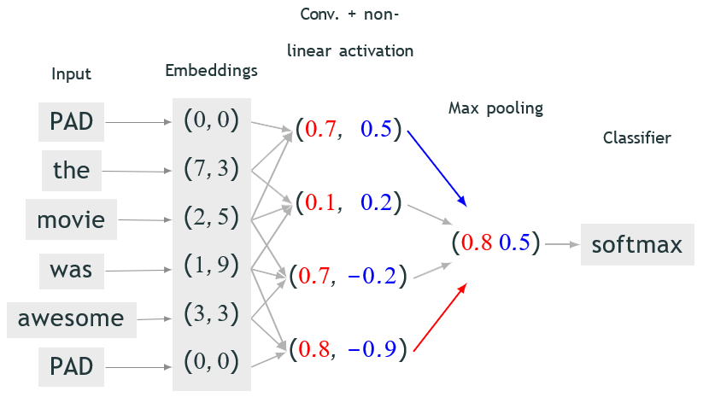
Classification with convolution and pooling
Convolutional Neural Networks
Usually we have many filters (hundreds or thousands), not just one
They may be of same or of different sizes

Slide 33
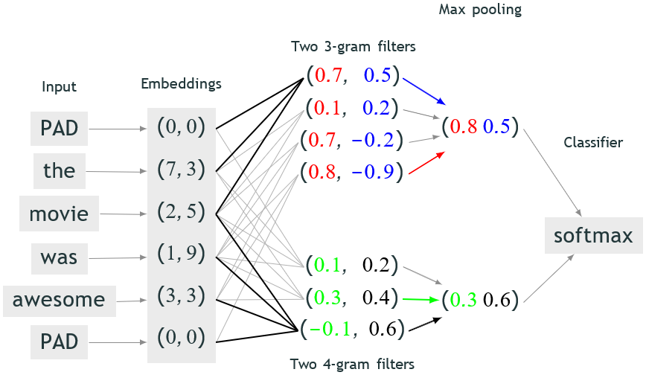
Classification with convolution and pooling
Convolutional Neural Networks

Slide 34
Properties of pooling
Convolutional Neural Networks
Idea: Extracting relevant features independent of their position in the input
Problems:
Output remains the same if a feature occurs once or multiple times
The music was great, but the cast was horrible, the plot was horrible and the costumes were horrible.

Slide 35
Efficacy of CNNs in NLP
Convolutional Neural Networks
In computer vision
Effectiveness of deep CNNs can be very well explained
Primary conv. layers detect the edges of an object
As we go deeper, more complex features of an image are learnt
In NLP
Not much understanding

